Slide 1

Report on definitive data timelines Definitive Data Subcommittee
Intermagnet Meeting Online, September 27 – October 1, 2021

Slide 2
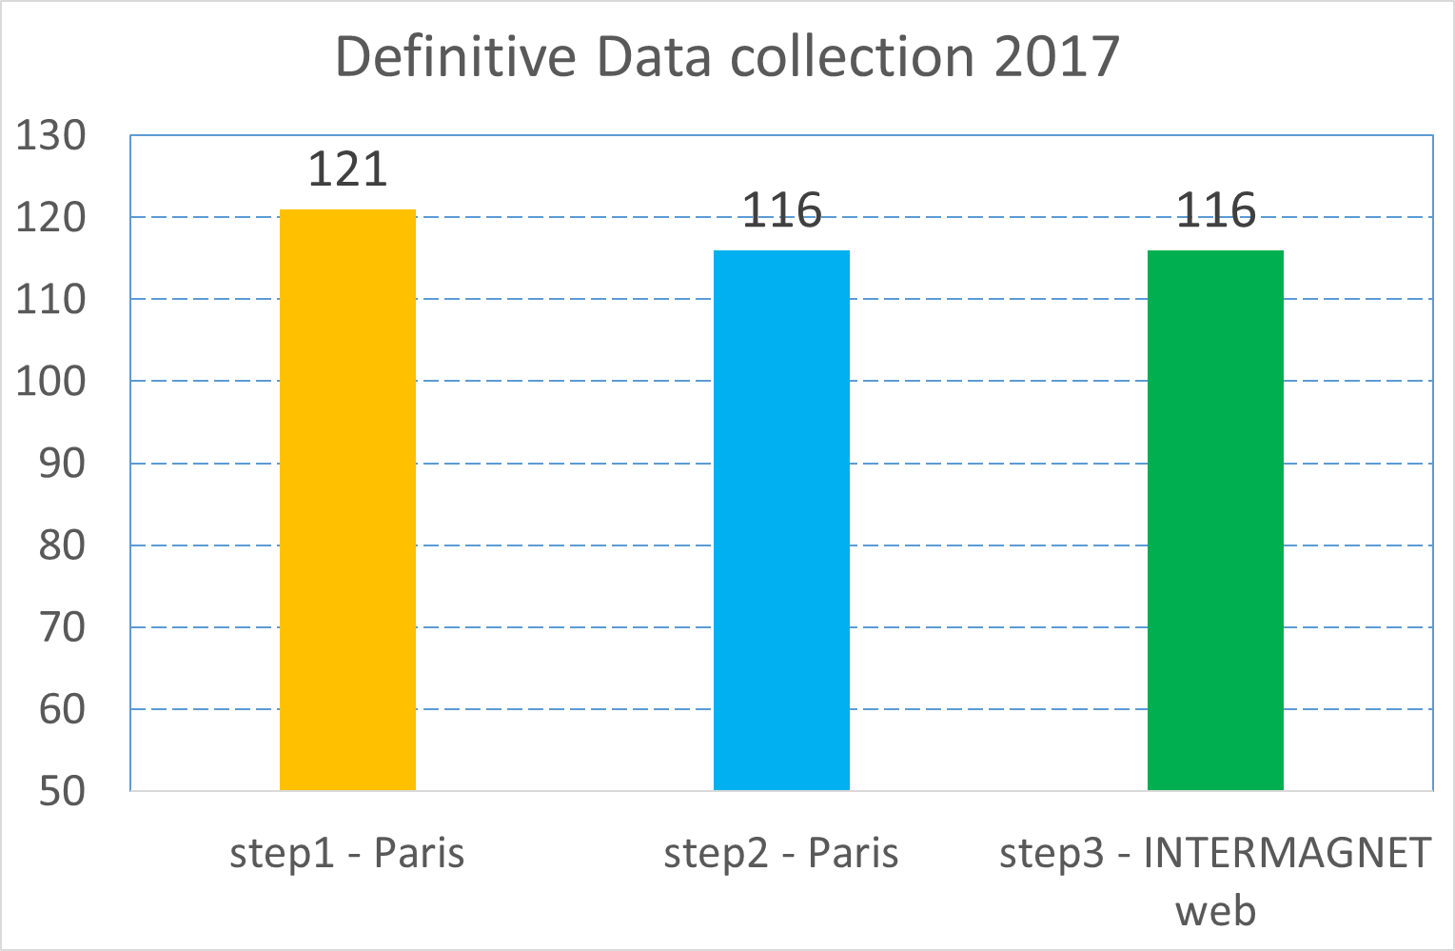
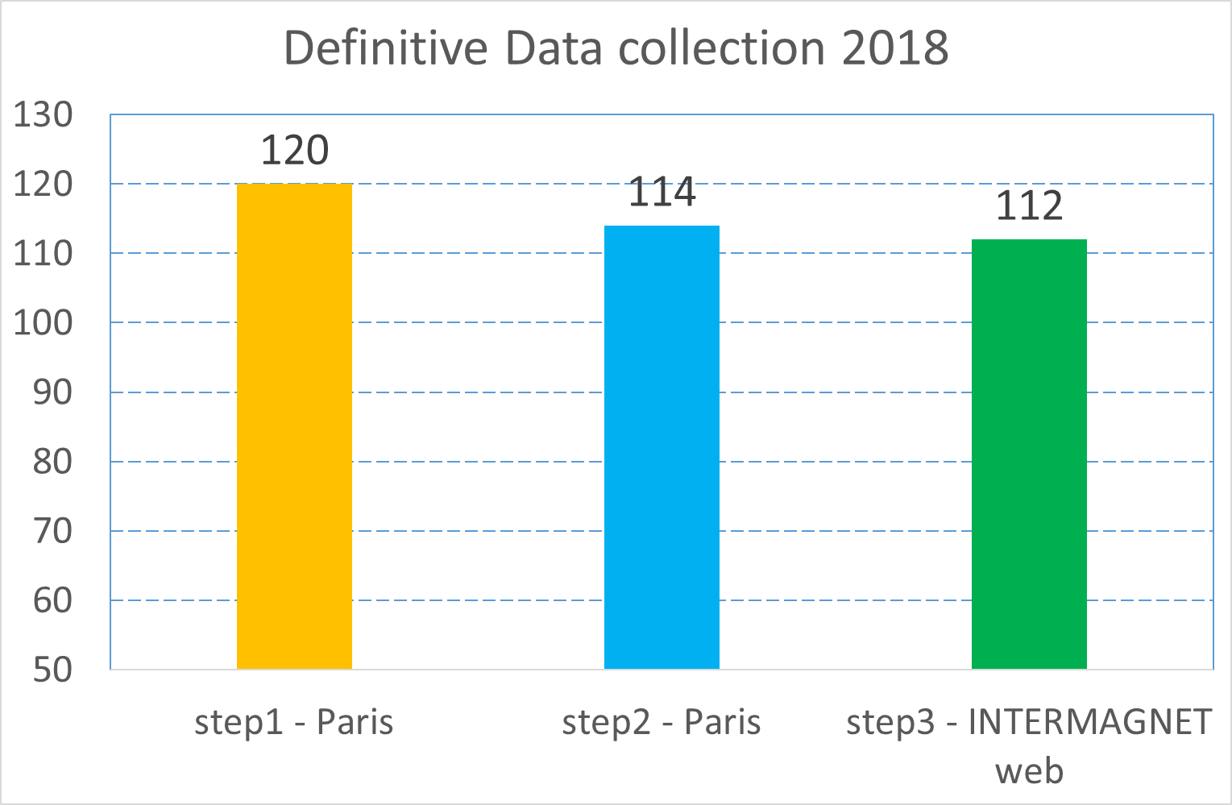
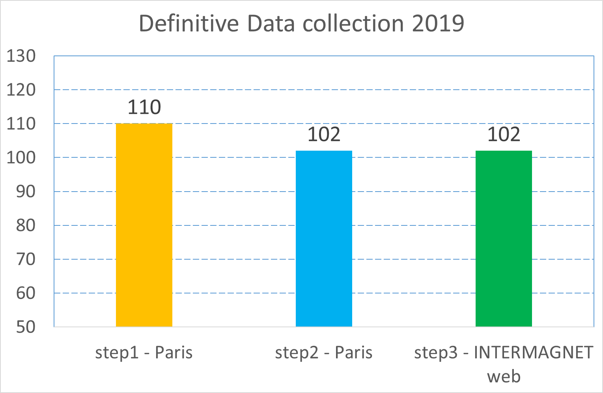
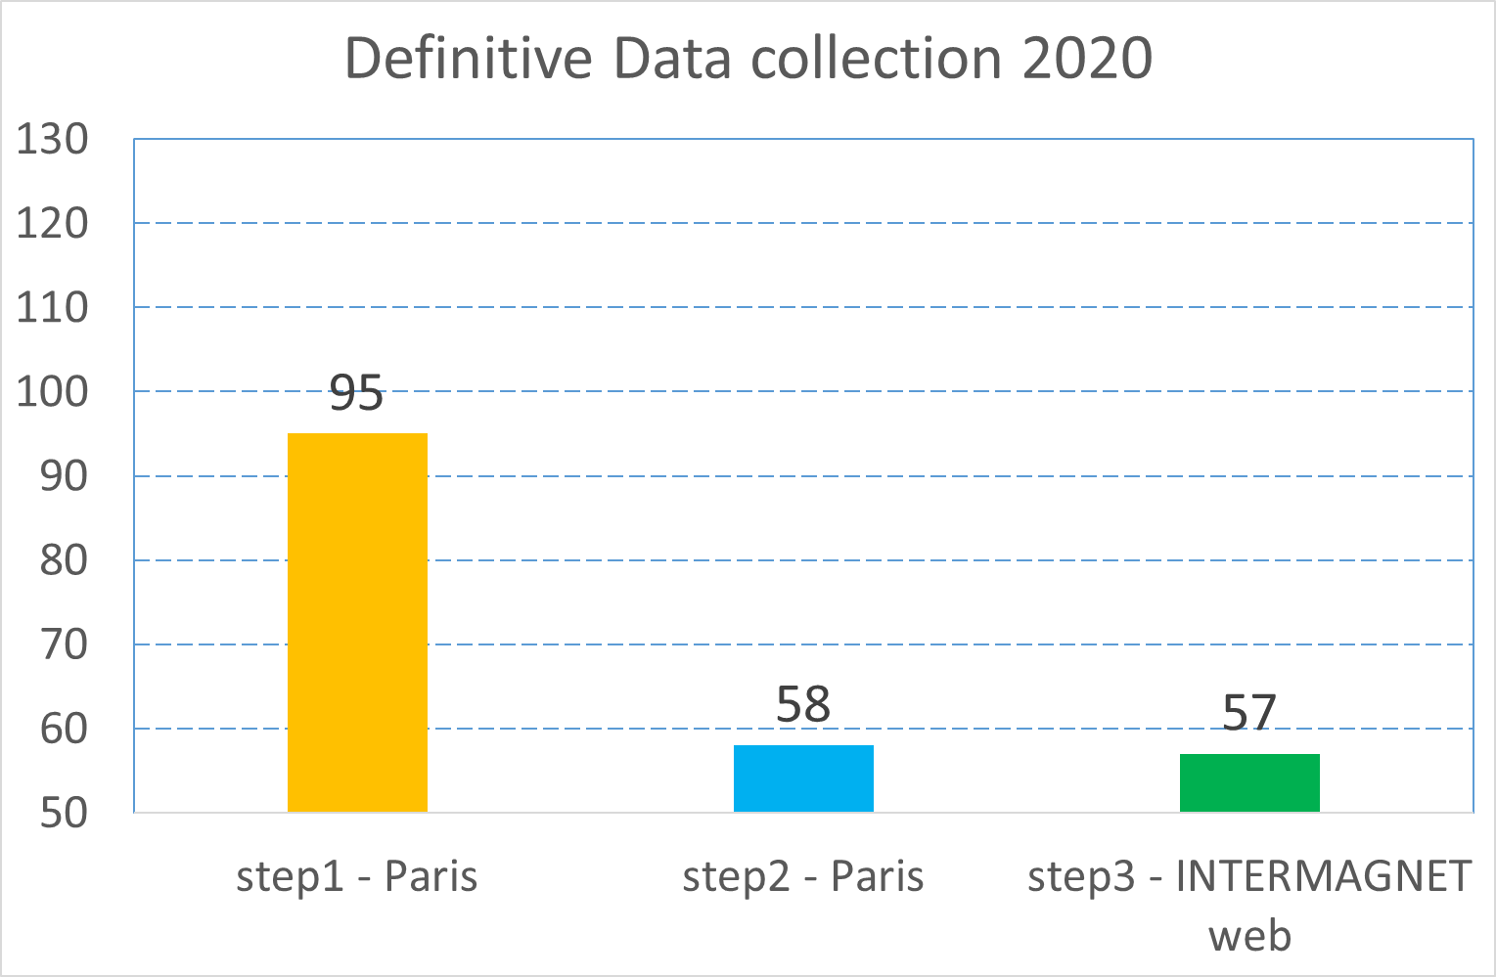
One-minute definitive data collection Summary of 2017, 2018, 2019, 2020 (situation in mid-September, 2021)
Already
published
as DOI
Will be
published
as DOI
soon

Slide 3
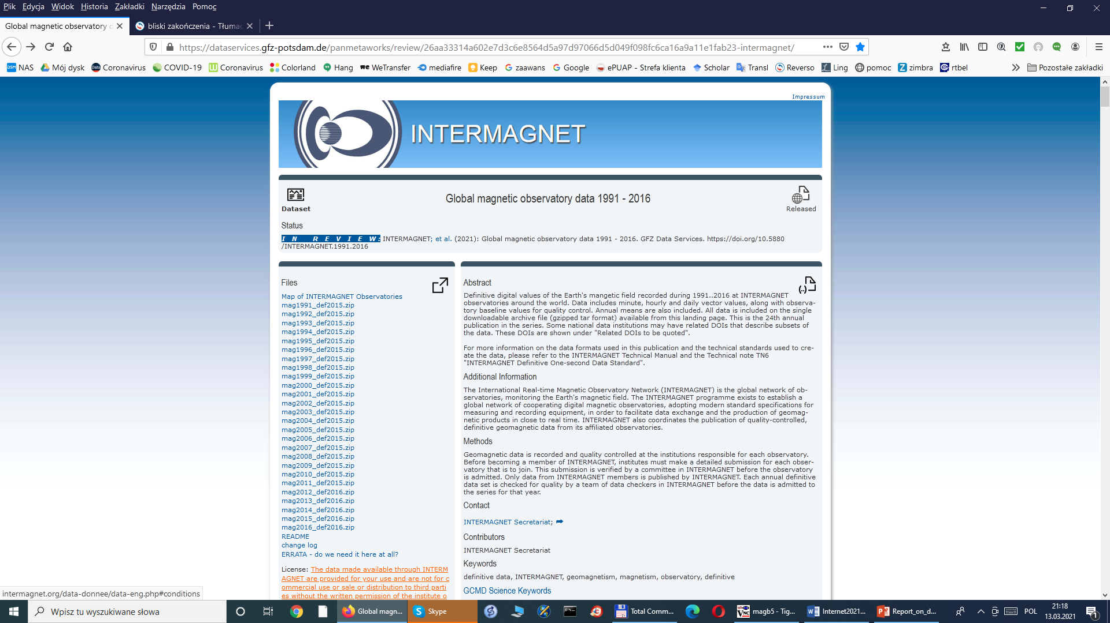
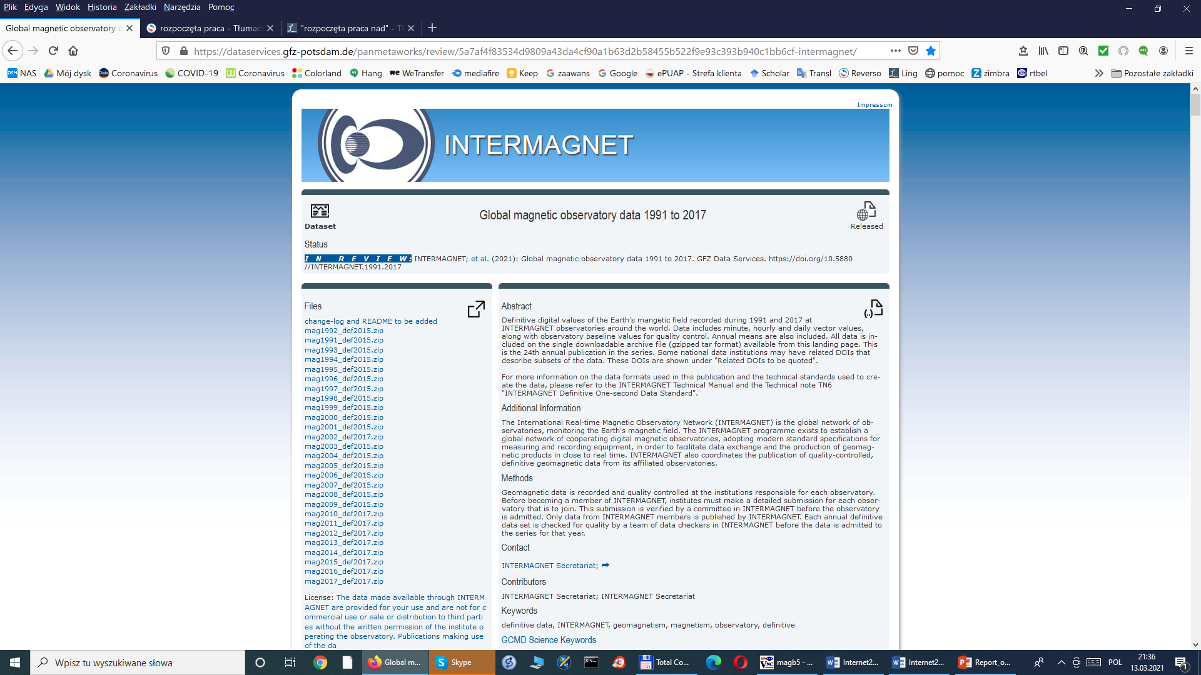
Current state on IRDS/DOI publications of 1-min definitive (changes since Internet 2021 March online Meeting)
IRDS2016 (1991-2016) DOI fully released after March 2021 Meeting
IRDS2017 (1991-2017) DOI fully released after March 2021 Meeting
IRDS2018 (1991-2018) is very close to completion
Remains to be done final completion country/institute metadata files
Remark: new country/institute maps have been prepared by Achim
2016 116 IMOs
1991-2016 147 IMOs
2017 114 IMOs
1991-2017 148 IMOs
2018 110 IMOs
1991-2018 149 IMOs

Slide 4
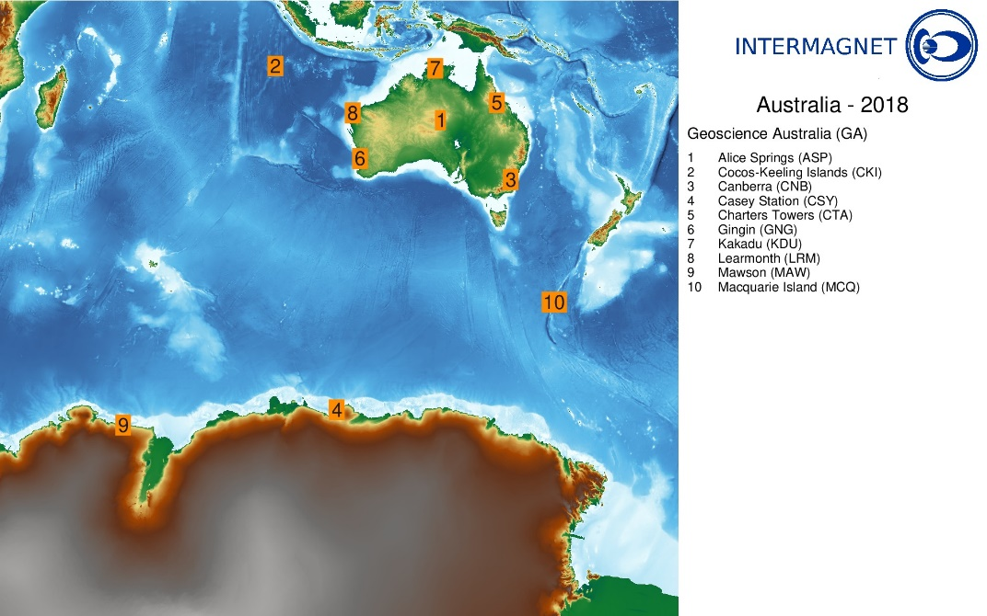
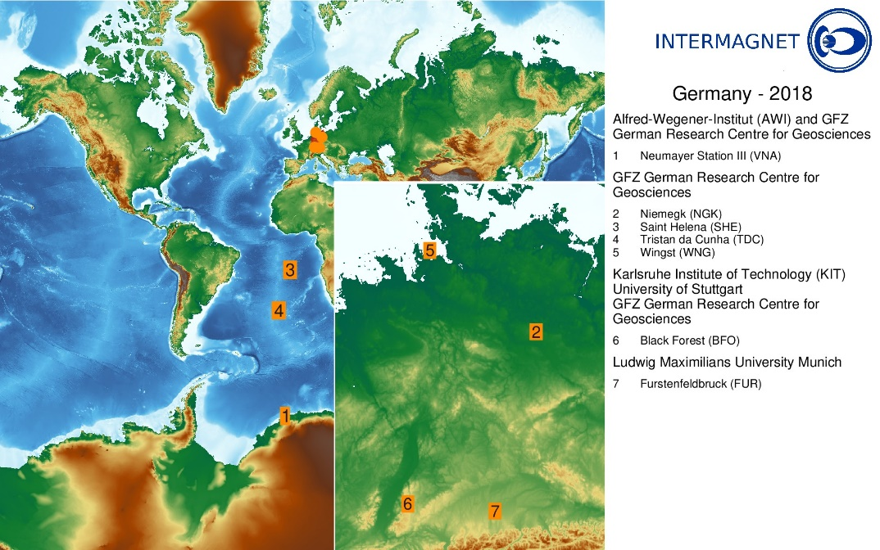
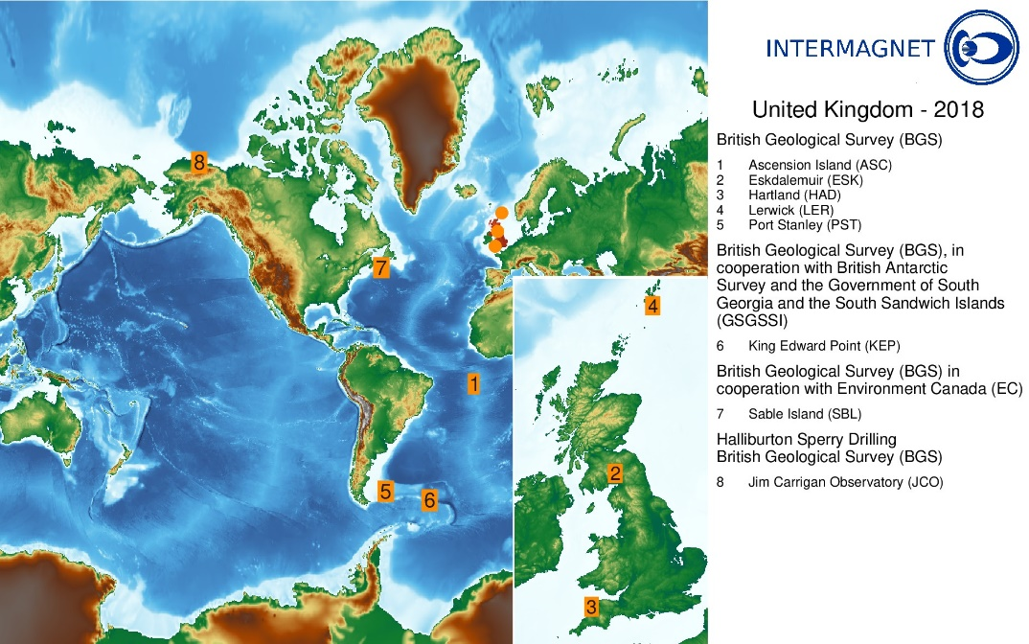
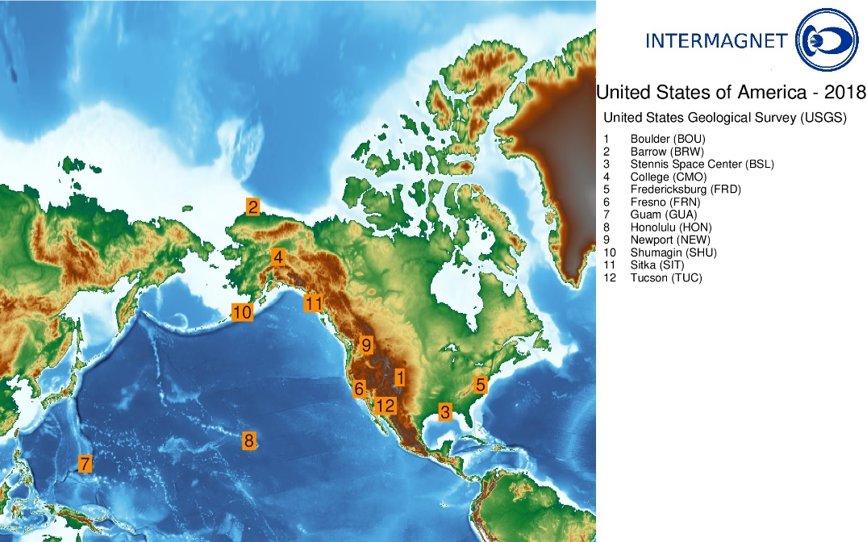
Example of country/institute maps prepared for IRDS2018

Slide 5
Summary of released DOI so far
Published years | Address | Number of IMOs All years / last year | Publication year
2013 | https://doi.org/10.5880/INTERMAGNET.2013 | 112 / 112 | 2017
2014 | https://doi.org/10.5880/INTERMAGNET.2014 | 112 / 112 | 2019
1991-2015 | https://doi.org/10.5880/INTERMAGNET.1991.2015 | 145 / 117 | 2020
1991-2016 | https://doi.org/10.5880/INTERMAGNET.1991.2016 | 147 / 116 | 2021
1991-2017 | https://doi.org/10.5880/INTERMAGNET.1991.2017 | 148 / 114 | 2021
1991-2018 | Compiled except of 2018 country/institute files | 149 / 110

Slide 6
Thank you for your attention !

